Slide 1
Action points for schools re academisation
Vicki Hair, Associate
Wednesday 7th December 2022
brownejacobson.com
linkedin.com/company/brownej

Slide 2
Agenda
Actions for Governors
Actions for senior leaders
Meeting and questionnaire
Property
Construction
Employment
Business
Questions?

Slide 3
Actions for Governors

Slide 4
Actions for Governors
First GB meeting – end of month three months prior to conversion
E.g. 1st April 2023 conversion date, first GB meeting by end of January 2023
Reviewing and approving draft docs based on precedents
Second GB meeting – end of month two months prior to conversion
E.g. 1st April 2023 conversion date, first GB meeting by end of February 2023
Reviewing final docs and due diligence and passing formal resolution to convert
Dates slightly different if converting on 1st September due to summer break
E.g. first GB meeting by end of June
Final GB meeting by end of July

Slide 5
Actions for senior leaders

Slide 6
Meeting and questionnaire
Complete a questionnaire (either a Browne Jacobson questionnaire or a MAT questionnaire)
Takes about an hour
Gives the lawyers the information they need to advise the school on issues
Kick off meeting with lawyers
Attended by HT, business manager/bursar and potentially Chair (although not strictly required)
MAT can attend too
Takes at least two hours
Can be virtual or in person
Answer any questions you have, run through issues highlighted by questionnaire, guide school through process

Slide 7
Property
Don’t worry! You don’t need to know everything!
Do you have playing fields? Do you share them?
Are you a Religious Order school or do you have a RO next door or onsite?
Do you have a substation or a telephone mast or railway tracks or stream onsite?
Does a staff member live in accommodation on site?
Do you share the site with anyone (RO, private nursery, tennis club)?
We do all the research with the Diocese and Council for you but may ask you to check plans

Slide 8
Construction
Any building works during:-
The past 12 years; AND
GB or Council was contracting authority; AND
Worth more than £25,000.
Transferring warranties to the MAT
Ignore any works where Diocese was contracting authority
Ignore where the money came from (DFC, LVCAP etc.) – who signed the contract?

Slide 9
Employment (1)
Transfer of Undertakings (Protection of Employees) Regulations or “TUPE”
GB is the current employer, MAT is the future employer
Any “measures”?
Positive – gain benefits
Negative – lose benefits
Neutral – just different
MAT decides on Measures, GB conveys information to staff and unions and “consults” Work with MAT to agree measures and communicate with staff and unions
Use your HR advisors if you have paid them (or can pay them) for TUPE support

Slide 10
Employment (2)
No set time period for consultation
Staff and unions can make “representations” on proposed changes right up until conversion
GB takes representations into account when making decision in second GB meeting
Consultation not a referendum

Slide 11
Business
Bank accounts
Revenue account is frozen on conversion and end of year reconciliation process with Council
School fund account(s) transfer across to MAT
Speak to MAT to see how bank accounts will operate when an academy
Contracts, subscriptions, SLAs/buy-back, licenses, leases etc.
Biggest single job of whole conversion process
Put together a complete list of everything you have
Speak to MAT about which will transfer and which will end of conversion
Identify “key” contracts and notify suppliers about proposed conversion
List of assets outside or taken home by staff/students
List of assets inside school that belong to Council (e.g. catering equipment, library books etc.)

Slide 12
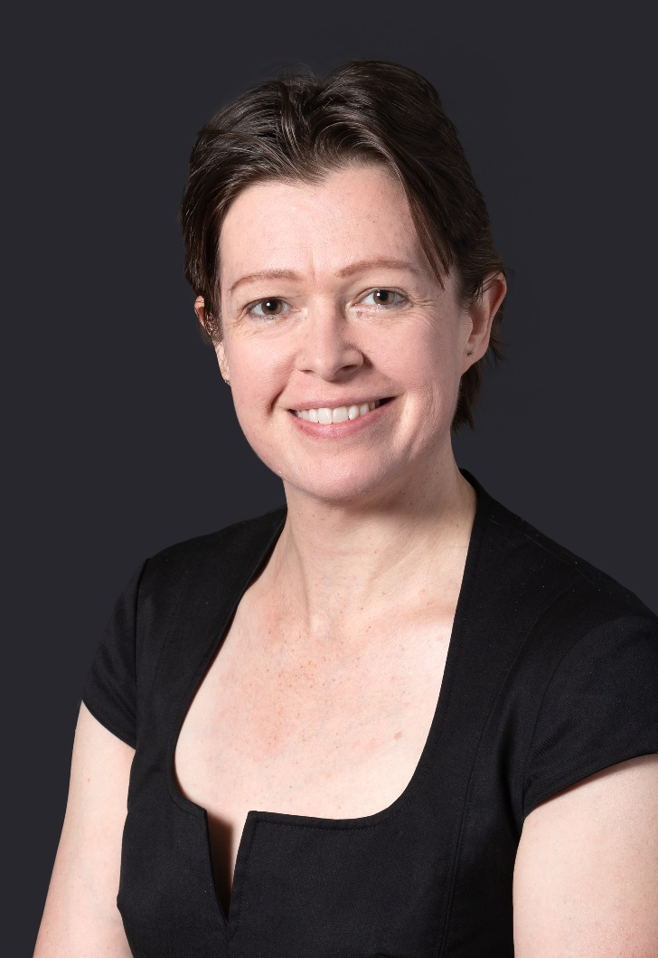
Talk to us…
Vicki Hair
Associate
t: 0115 976 6197
e: vicki.hair@brownejacobson.com

Slide 13
Questions to the panel?

Slide 14
Please note:
The information contained in these notes is based on the position at 7th December 2022. It does, of course, only represent a summary of the subject matter covered and is not intended to be a substitute for detailed advice. If you would like to discuss any of the matters covered in further detail, our team would be happy to do so.
© Browne Jacobson LLP 2022. Browne Jacobson LLP is a limited liability partnership.

