Slide 1
Primary Annual Standards Review
Primary School Name:
Date of review:
Note: Some 2024 data has already been centrally collected to reduce workload)

Slide 2
Contextual Information (PROVIDED BY TRUST) BUT please complete BAPTISED CATHOLICS
PAN: xxx
Year Group | No on Roll | No Baptised Catholics | Boys | Girls | Disadvantaged pupils | Pupils with SEND support | Pupils with EHCP | EAL
Nur PAN xx
Rec PAN xx
Y1
Y2
Y3
Y4
Y5
Y6
Total number
Data over time | No on Roll | % Baptised Catholics | % Boys | % Girls | % Disadvantaged pupils | % Pupils with SEND support | % Pupils with EHCP | % EAL
2024
2023
2022
2021

Slide 3
Leadership Structure Please include EHT/HT/HOS/DHT/AHT/TLRs
Role | Name | Length of time in post

Slide 4
Talent Mapping Please record staff who you have identified as future leaders or are able to offer cross trust working. This may be non-teaching staff.
Name of staff member | Role | Key strengths

Slide 5
Staffing changes from previous September to date
Staff group | Details
Leadership changes
Teaching staff changes
Number of ECTs from September 2023
Number of ECTs from September 2024
Other staff changes, e.g. SBM, Site Manager
Number of redundancies
Other information

Slide 6
CSI Inspection
Date of last Inspection: xx/xxxx | Latest S48 | Self-evaluation
OVERALL EFFECTIVENESS
CATHOLIC LIFE AND MISSION
Pupil outcomes: the extent to which pupils contribute to and benefit from the Catholic life and mission of the school
Provision: the quality of provision for the Catholic life and mission of the school
Leadership: how well leaders and governors promote, monitor and evaluate the provision for the Catholic life and mission of the school
RELIGIOUS EDUCATION
Pupil outcomes: how well pupils achieve and enjoy their learning in religious education
Provision: the quality of teaching, learning and assessment in religious education
Leadership: how well leaders and governors promote, monitor, and evaluate the provision for religious education
COLLECTIVE WORSHIP
Pupil outcomes: how well pupils participate in and respond to the schools’ collective worship
Provision: the quality of collective worship provided by the school
Leadership: how well leaders and governors promote, monitor, and evaluate the provision for collective worship

Slide 7
Previous Section 48 Inspection Areas for improvement
OVERALL EFFECTIVENESS
CATHOLIC LIFE
RELIGIOUS EDUCATION
COLLECTIVE WORSHIP

Slide 8
Ofsted
Date of last inspection: xx/xxxx | Latest Judgement | Self-evaluation
OVERALL EFFECTIVENESS
The quality of education
Behaviour and attitudes
Personal development including SMSC
Leadership and Management (including safeguarding)
Quality of provision in early years education

Slide 9
Areas for Development from most recent Ofsted inspections
OVERALL EFFECTIVENESS
1.
2.
3.
4.

Slide 10
EYFS Baseline and GLD (SCHOOL TO COMPLETE)
 | Average baseline in Nursery (e.g. 22 – 36 months)
2023
2022
 | Average baseline in Reception (e.g. 22 – 36 months)
2023
2022
 | End of Reception % GLD
2023
2022
Prime and Specific Areas of Learning and Development for 2024
Strengths:
Areas for improvement:

Slide 11
Phonics – Year 1 and Year 2 screening check (SCHOOL TO COMPLETE)
Year 1 | % achieving expected standard
2023
2022
Year 2 | % achieving expected standard
2023
2022
Scheme used by school:

Slide 12
KS1 SATS (SCHOOL TO COMPLETE)
% achieving | Reading EXS+ | Reading GDS | Writing EXS+ | Writing GDS | Maths EXS+ | Maths GDS | RWM EXS+ | RWM GDS
2023
2022
Comments on significant achievements or under-achievements by cohort or key groups for 2024:

Slide 13
KS2 SATS Attainment (SCHOOL TO COMPLETE)
 | Reading EXS+ | Reading GDS | Writing EXS+ | Writing GDS | Maths EXS+ | Maths GDS | GPS EXS+ | GPS GDS | RWM EXS+ | RWM GDS
2023
2022
Comments on significant achievements or under-achievements by cohort or key groups for 2024:

Slide 14
KS2 SATS Progress (Historical) school to complete
 | Reading Progress Score | Writing Progress Score | Maths Progress Score
2023
2022
2024/25 Key Stage 2 Performance Measures
As primary tests and assessments were cancelled in academic years 2019/20 and 2020/21 due to COVID-19 disruption, there will be no relevant KS1 data which is required to calculate primary progress measures for 2023/24 and 2024/25. Given the lack of a statistically robust alternative baseline to calculate primary progress measures, the DFE will not be producing or publishing primary progress measures for 2023/24 and 2024/25, and instead will only publish the usual attainment measures as set out on page 12 for these years. https://assets.publishing.service.gov.uk/media/6602ed6065ca2fa78e7da92e/Primary_school_accountability_2023_technical_guide.pdf

Slide 15
Target Setting for 2024-25 (FFT generated via Trust)
 |  | Reading EXS+ | Writing EXS+ | Maths EXS+ | RWM EXS+ | Reading GDS+ | Writing GDS+ | Maths GDS+ | RWM GDS+
Year 6 No. in cohort = xx | No. of children
 | %
Year 2 No. in cohort = xx | No. of children
 | %

Slide 16
Absence and Exclusions (centrally completed)
 | 2021/22 | 2022/23 | 2023/24
Sessions missed due to overall absence
Persistent absentees - absent for 10% or more sessions
No. of suspensions
No. of permanent exclusions
Additional comments on 2023/24:

Slide 17
Other contextual factors Please complete
 | 2021/22 | 2022/23 | 2023/24
Number of pupils who left the school register in year
Number of pupils who joined the school register in year
Number of pupils attending alternative provision (AP)
Number of pupils who have gone missing from education (CME)
Recorded cases of bullying
Recorded cases of sexualised language and/or behaviour
Recorded cases of racist, homophobic or derogatory language and /or behaviours
Additional comments on 2023/24:

Slide 18
Safeguarding (please complete) Please record the highest number during the academic year
 | 2021/22 | 2022/23 | 2023/24
Number of pupils at Child Protection
Number of pupils at Child in Need
Number of pupils receiving early help
Number of pupils under special guardianship (those pupils who have a Personalised Education Plan)
Additional comments on 2023/24:

Slide 19
School Strengths
1.
2.
3.
4.
5.

Slide 20
School Improvement Priorities
1.
2.
3.
4.
5.

Slide 21
School improvement evaluation for discussion and agreement

Slide 22
Self-Evaluation
Ofsted self-evaluation
Inadequate
Requires Improvement
Good
Outstanding
School Improvement judgement
Stabilise
Repair
Improve
Sustain
Trajectory
Weakest system performers
Improver decliners
Steady improver
Steady and secure
Slow decliners
Rapid decliners
Rapid improvers
Strongest performers

Slide 23
The Eight Improvement Trajectories that underpin school improvement by Sir David Carter

Slide 24
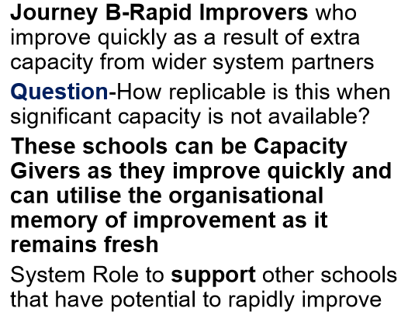
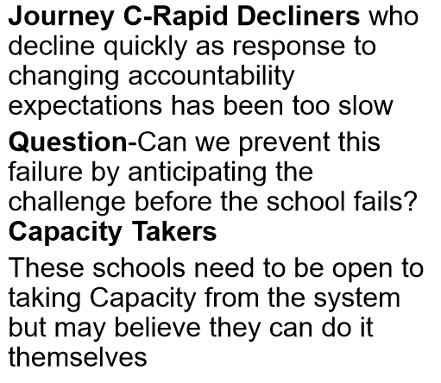
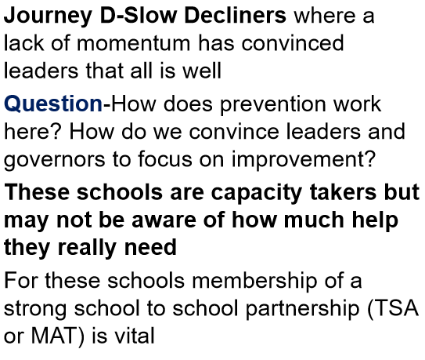
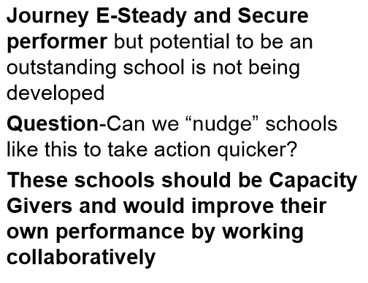
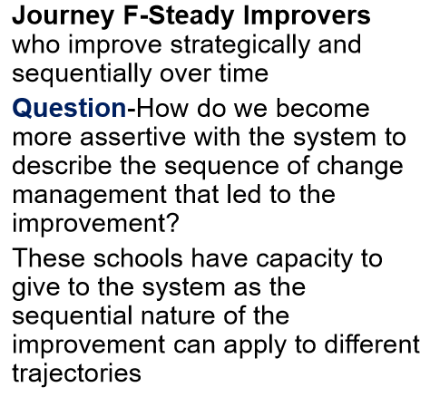
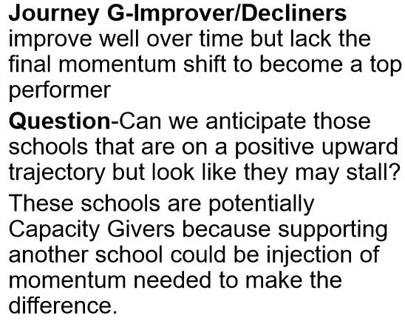
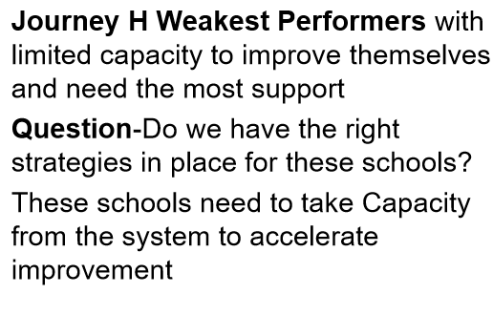
The Eight Improvement Trajectories that underpin school improvement by Sir David Carter

Slide 25
Self-Evaluation agreement for discussion and agreement at ASR
Ofsted self-evaluation | Ofsted judgement | School judgement | Agreed judgement
Inadequate
Requires Improvement
Good
Outstanding
Trajectory | School judgement | Agreed judgement
Weakest system performers
Improver decliners
Steady improver
Steady and secure
Slow decliners
Rapid decliners
Rapid improvers
Strongest performers
School Improvement judgement | School judgement | Agreed judgement
Stabilise
Repair
Improve
Sustain

Slide 26
Agreed actions (School proposals to be agreed at ASR)
Agreed Action | School Improvement or other central team support | Timescale

Slide 27
Date of review
Name of school staff present
Name of LGB members present
Name of CSEL/CEO
Name of RPO

