Slide 1
Secondary Annual Standards Review
School Name:
Date of review:

Slide 2
Contextual Information (please complete Baptised only)
PAN: xxx
Year Group | No on Roll | No Baptised Catholics | Boys | Girls | Disadvantaged pupils | Pupils with SEND support | Pupils with EHCP | EAL
Y7
Y8
Y9
Y10
Y11
Total number
Data over time | No on Roll | % Baptised Catholics | % Boys | % Girls | % Disadvantaged pupils | % Pupils with SEND support | % Pupils with EHCP | % EAL
2024
2023
2022

Slide 3
Leadership Structure Please include EHT/HT/HOS/DHT/AHT/TLRs
Role | Name | Length of time in post

Slide 4
Talent Mapping Please record staff who you have identified as future leaders or are able to offer cross trust working. This may be non-teaching staff.
Name of staff member | Role | Key strengths

Slide 5
Staffing changes from previous September to date
Staff group | Details
Leadership changes
Teaching staff changes
Number of ECTs from September 2023
Number of ECTs from September 2024
Other staff changes, e.g. SBM, Site Manager
Number of redundancies
Other information

Slide 6
CSI Inspection
Date of last Inspection: xx/xxxx | Latest S48 | Self-evaluation
OVERALL EFFECTIVENESS
CATHOLIC LIFE AND MISSION
Pupil outcomes: the extent to which pupils contribute to and benefit from the Catholic life and mission of the school
Provision: the quality of provision for the Catholic life and mission of the school
Leadership: how well leaders and governors promote, monitor and evaluate the provision for the Catholic life and mission of the school
RELIGIOUS EDUCATION
Pupil outcomes: how well pupils achieve and enjoy their learning in religious education
Provision: the quality of teaching, learning and assessment in religious education
Leadership: how well leaders and governors promote, monitor, and evaluate the provision for religious education
COLLECTIVE WORSHIP
Pupil outcomes: how well pupils participate in and respond to the schools’ collective worship
Provision: the quality of collective worship provided by the school
Leadership: how well leaders and governors promote, monitor, and evaluate the provision for collective worship

Slide 7
Previous Section 48 Inspection Areas for improvement
OVERALL EFFECTIVENESS
CATHOLIC LIFE
RELIGIOUS EDUCATION
COLLECTIVE WORSHIP

Slide 8
Ofsted
Date of last inspection: xx/xxxx | Latest Judgement | Self-evaluation
OVERALL EFFECTIVENESS
The quality of education
Behaviour and attitudes
Personal development including SMSC
Leadership and Management (including safeguarding)
Quality of provision in early years education

Slide 9
Areas for Development from most recent Ofsted inspections
OVERALL EFFECTIVENESS
1.
2.
3.
4.

Slide 10
KS3 Data NO UNTIL GL ASSESSMENT
 | RE |  | English Language |  | English Literature |  | Maths |  | Science
 | % ARE | % above ARE | % ARE | % above ARE | % ARE | % Above ARE | % ARE | % above ARE | % ARE | % above ARE
2024
2023
ARE = on track to achieve grade 4 or above in two years’ time
ARE = on track to achieve grade 5 or above in two years’ time
Above ARE = on track to achieve grade 8 and 9 in two years’ time

Slide 11
KS4 Data (2024 will be prepopulated)
 | No. of pupils at end of KS4 | Progress 8 |  |  | % grade 5 or above in Eng. & Maths GCSE | Attainment 8 score | Entering EBacc | EBacc average point score | Staying in education or entering employment
 |  | No. of pupils included in score | Score | Disadvantaged
2023
2022

Slide 12
Absence and Exclusions CENTRALLY COMPLETED
 | 2021/22 | 2022/23 | 2023/24
Sessions missed due to overall absence
Persistent absentees - absent for 10% or more sessions
No. of suspensions
No. of permanent exclusions
Additional comments on 2023/24:

Slide 13
Other contextual factors
 | 2021/22 | 2022/23 | 2023/24
Number of pupils who left the school register in year
Number of pupils who joined the school register in year
Number of pupils attending alternative provision (AP)
Number of pupils who have gone missing from education (CME)
Recorded cases of bullying
Recorded cases of sexualised language and/or behaviour
Recorded cases of racist, homophobic or derogatory language and /or behaviours
Additional comments on 2023/24:

Slide 14
Safeguarding Please record the highest number during the academic year
 | 2021/22 | 2022/23 | 2023/24
Number of pupils at Child Protection
Number of pupils at Child in Need
Number of pupils receiving early help
Number of pupils under special guardianship (those pupils who have a Personalised Education Plan)
Additional comments on 2023/24:

Slide 15
School Strengths
1.
2.
3.
4.
5.

Slide 16
School Improvement Priorities
1.
2.
3.
4.
5.

Slide 17
School improvement evaluation for discussion and agreement

Slide 18
Self-Evaluation
Ofsted self-evaluation
Inadequate
Requires Improvement
Good
Outstanding
School Improvement judgement
Stabilise
Repair
Improve
Sustain
Trajectory
Weakest system performers
Improver decliners
Steady improver
Steady and secure
Slow decliners
Rapid decliners
Rapid improvers
Strongest performers

Slide 19
The Eight Improvement Trajectories that underpin school improvement by Sir David Carter

Slide 20
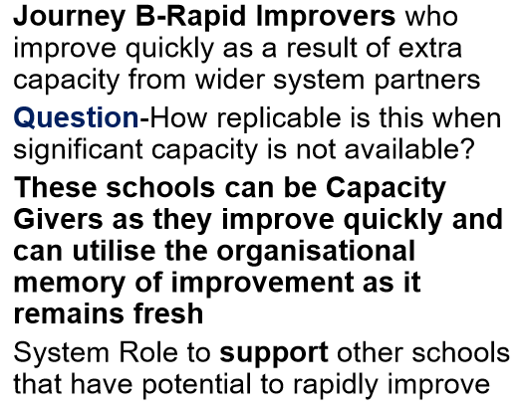
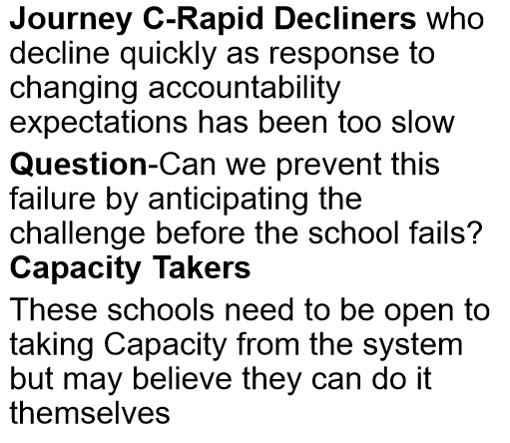
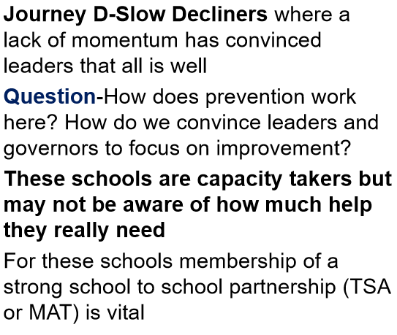
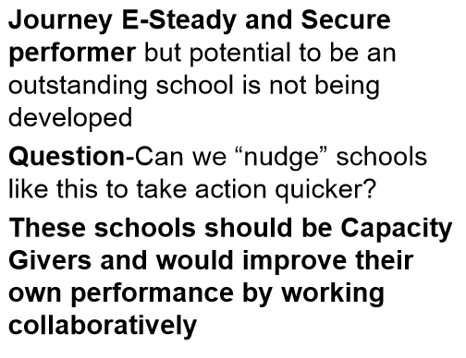
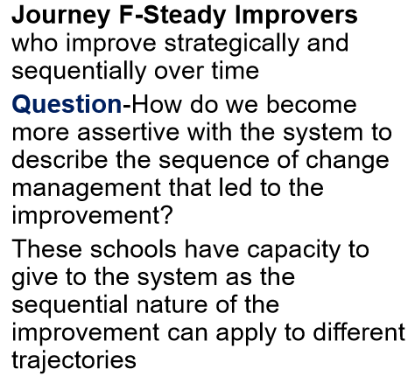
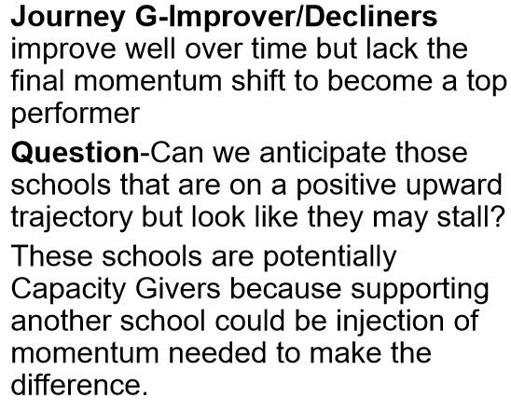
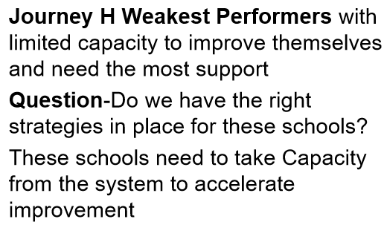
The Eight Improvement Trajectories that underpin school improvement by Sir David Carter

Slide 21
Self-Evaluation agreement (to be agreed at ASR meeting)
Ofsted self-evaluation | Ofsted judgement | School judgement | Agreed judgement
Inadequate
Requires Improvement
Good
Outstanding
Trajectory | School judgement | Agreed judgement
Weakest system performers
Improver decliners
Steady improver
Steady and secure
Slow decliners
Rapid decliners
Rapid improvers
Strongest performers
School Improvement judgement | School judgement | Agreed judgement
Stabilise
Repair
Improve
Sustain

Slide 22
Agreed actions
Agreed Action | School Improvement or other central team support | Timescale

Slide 23
Date of review
Name of school staff present
Name of LGB members present
Name of CPO | Phil Smith

